Slide 1

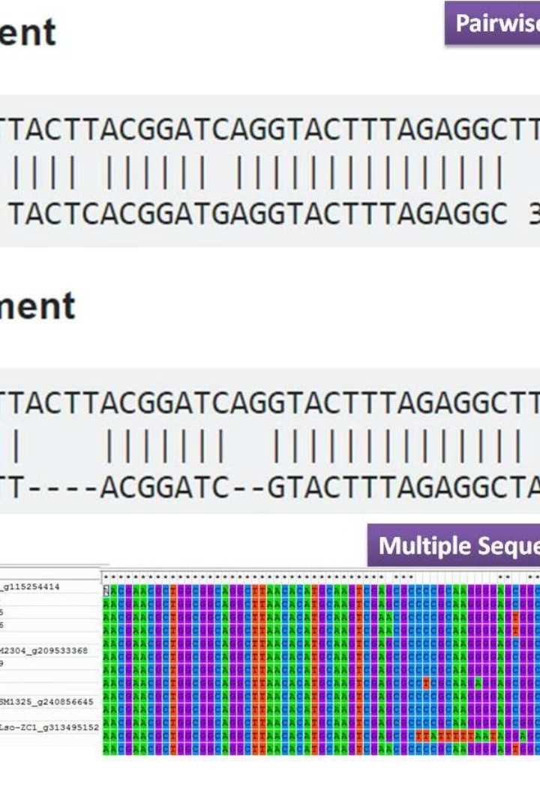
Introduction to Multiple Sequence Alignment
Multiple Sequence Alignment is a vital tool in bioinformatics for comparing and analyzing genetic sequences. It helps in identifying similarities and differences among multiple sequences, providing valuable insights into evolutionary relationships and conserved regions.

Slide 2
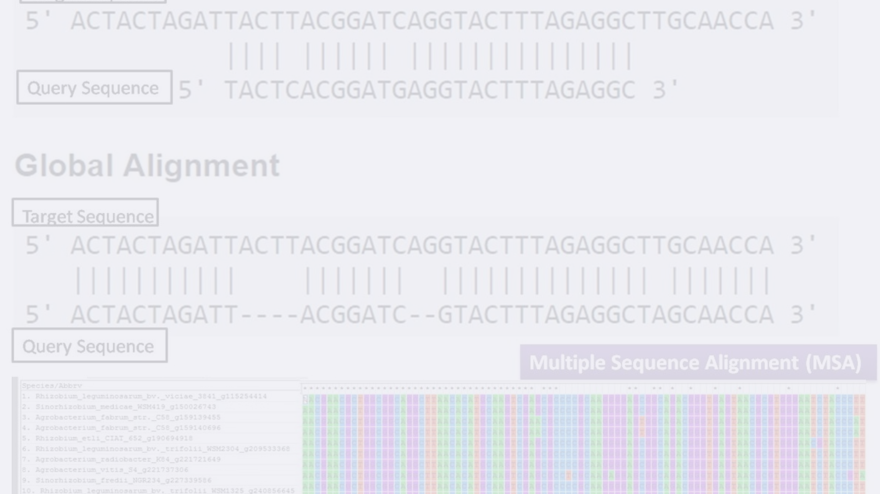
Importance of Sequence Alignment in Bioinformatics
1
Genetic Variation Analysis
2
Evidence of Evolution
3
Phylogenetic Studies
Reveals similarities and differences in DNA sequences, contributing to evolutionary studies.
Assists in understanding the evolutionary history and relationships among organisms.
Enables the study of genetic variations and mutations across different organisms.

Slide 3
Methods and Algorithms for Multiple Sequence Alignment
Progressive Alignment
Iterative Methods
Multiple Alignment Comparison
An iterative method that aligns sequences step by step, building the final alignment.
Uses iterative refinement to optimize the alignment, such as the popular PSI-BLAST.
Comparing multiple alignments to identify conserved regions and variations across sequences.

Slide 4
TOOLS for Multiple Sequence Alignment
Clustal Omega
1
A fast and scalable tool for multiple sequence alignment, suitable for aligning large numbers of sequences.
2
MAFFT
Multiple Alignment using Fast Fourier Transform is a versatile
tool that can handle a wide range of sequence types and sizes.

Slide 5



Challenges and Limitations of Multiple Sequence Alignment
Scalability
Non-Homologous Sequences
Highly Variable Regions
Aligning large sequences or a large number of sequences can be computationally intensive.
Dealing with sections of sequences that have high variability can affect accurate alignment.
Aligning sequences that are not evolutionarily related can be challenging.

Slide 6
Applications of Multiple Sequence Alignment in Biological Research
Phylogenetics
1
Studying evolutionary relationships among species using genetic data.
2
Functional Analysis
Comparing regions to understand function and structure of proteins and other biomolecules.
Annotation of Genomes
3
Identifying genetic elements and regulatory sequences in genomes.

Slide 7
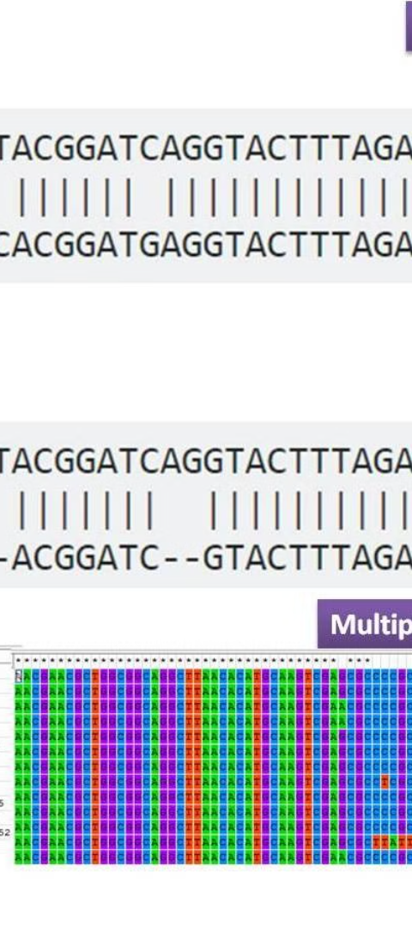
Comparative Analysis of Multiple Sequence Alignment Tools
Pairwise Alignment
Multiple Alignment
Focuses on the alignment of only two sequences at a time, revealing specific relationships.
Simultaneous comparison of multiple sequences, providing broader evolutionary insights.
Structural Alignment
Alignment based on the 3D structure of biological molecules, critical for structural genomics.

Slide 8



Case Studies Using Multiple Sequence Alignment
Genomic Studies
Biological Research
Medical Diagnosis
Understanding mutations, polymorphisms, and genetic predisposition to diseases.
Exploring evolutionary relationships and functional genomic regions.
Utilizing alignments for disease diagnosis and personalized medicine.

Slide 9
Future Trends in Multiple Sequence Alignment
Machine Learning Integration
Interactive Visualization
Personalized Genomics
Developing advanced tools for interactive and intuitive visualization of complex alignments.
Customized alignments for individualized genomic analysis and personalized medicine.
The adoption of machine learning algorithms to enhance the accuracy and efficiency of alignments.

Slide 10
Conclusion and Key Takeaways
The significance of sequence alignment in understanding genetic relationships
The need for advanced algorithms and data visualization tools
Applications in diverse fields, including medicine and ecology

